Slide 1
Master Thesis
Semantic Segmentation of Land Use with High-Resolution Orthophotos and Convolutional Neural Networks
Faculty of Mathematics and Computer Science
Karsten Köhler, Student ID No. 8690570

Slide 2
Content
Image Segmentation
Vegetation Analysis
Literature Review
Convolutional Neural Network
Reference Architectures
Dataset
Raster Preprocessing
Label Preparation
Experiments
Implementation
Metrics
Segmentation Results
Discussion
Literature Review
Spectral Vegetation Indices
Experiments
Implementation
Visualizations
Discussion

Slide 3
Research Question
Background: Emergency Landing Assistant, Emergency Landing Field Identification
Primary Objective: Semantic Segmentation of Land Use
Side Objective: Vegetation Density Analysis

Slide 4
Convolutional Neural Networks
Subset of Neural Networks
Highly efficient on grid-like data like e. g. images
Two common operations:
Convolution
Pooling

Slide 5
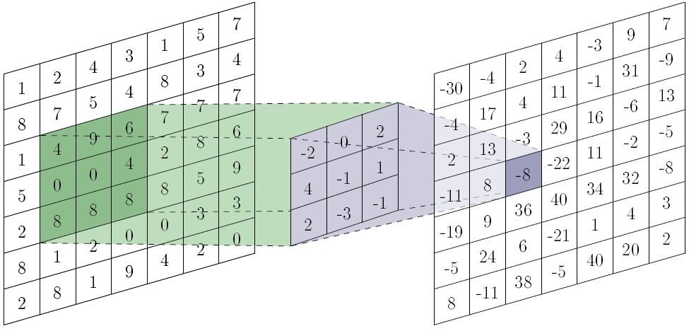

Convolution
Filter, move across image, learns shared parameters
hyperparameters: size, padding, stride
Produces convolved image (feature map)
https://towardsdatascience.com/a-comprehensive-guide-to-convolutional-neural-networks-the-eli5-way-3bd2b1164a53

Slide 6
Convolution
Multiple filters per convolution layer
Apply filters to previous feature maps
Filters can have depth
lots of computations required
Filters
Filters
Input
Feature Maps
Feature Maps

Slide 7
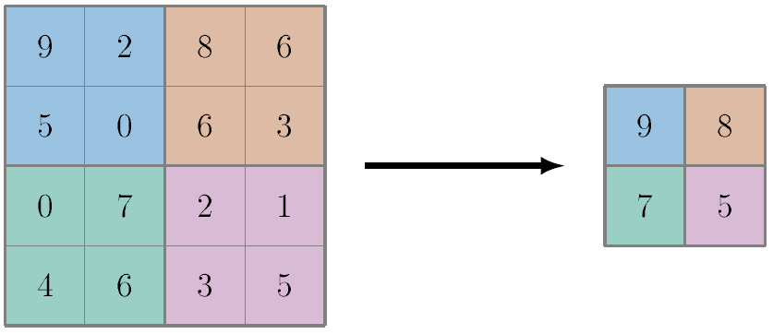
Pooling
Reduce spatial size
no trainable parameters
hyperparameters: size, padding, stride
Max Pooling

Slide 9
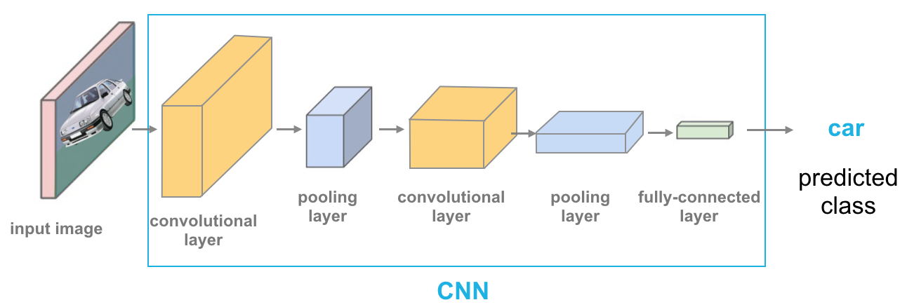
Example CNN Architecture
https://cezannec.github.io/Convolutional_Neural_Networks/

Slide 10
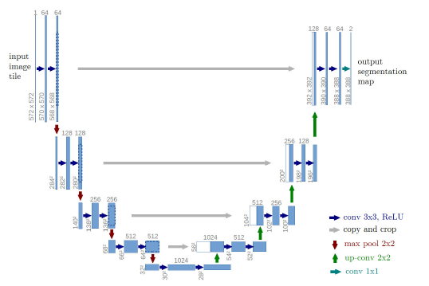
U-Net Architecture

Slide 11
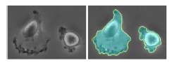
U-Net Metrics

Slide 12
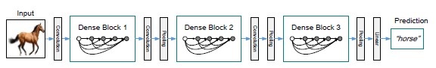
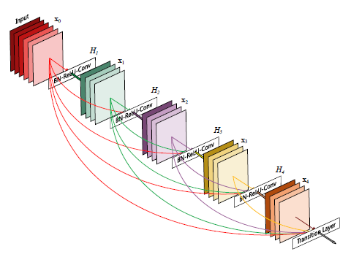
DenseNet Architecture

Slide 13
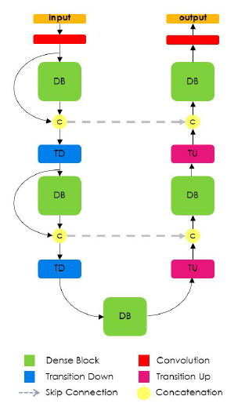
FC-DenseNet Architecture

Slide 14
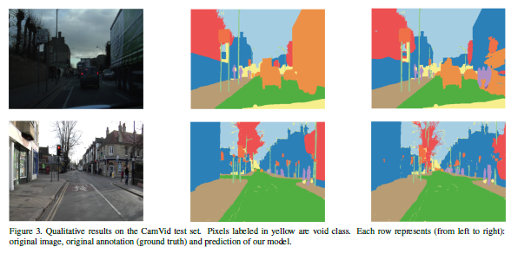
FC-DenseNet Metrics

Slide 15
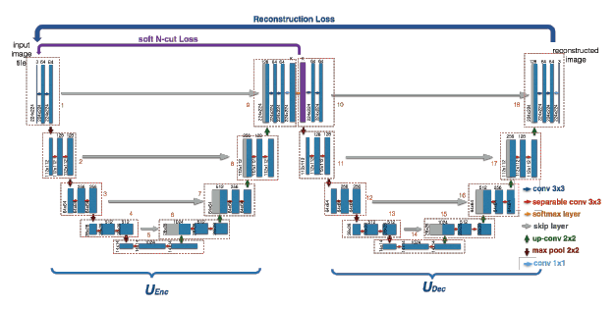
W-Net Architecture

Slide 16
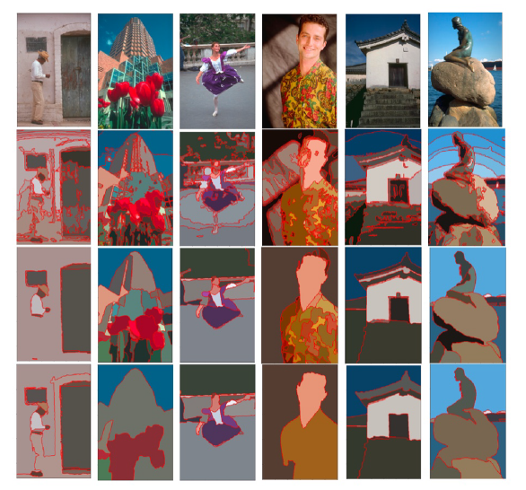
W-Net Metrics

Slide 17
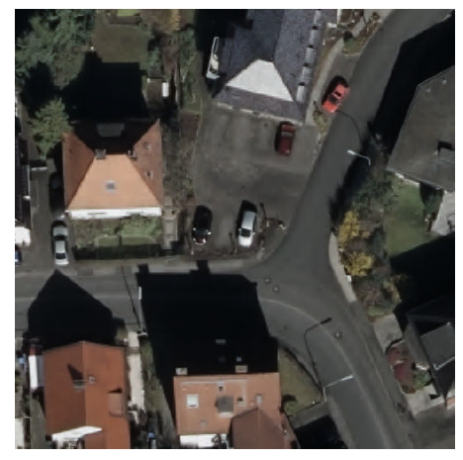
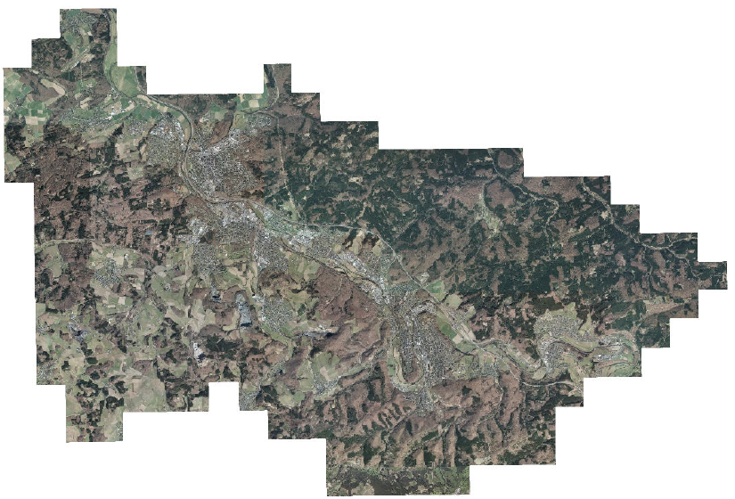
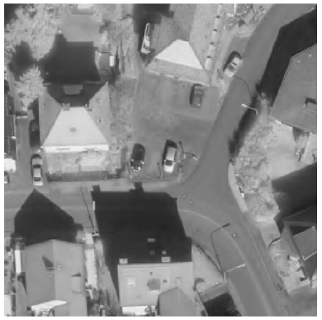
Digital Orthographic Photographs

Slide 18
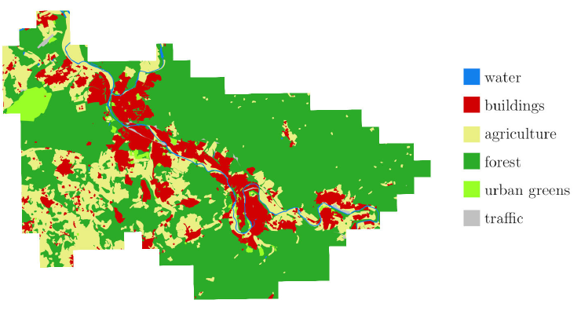
Vector Graphics with Land Use

Slide 19
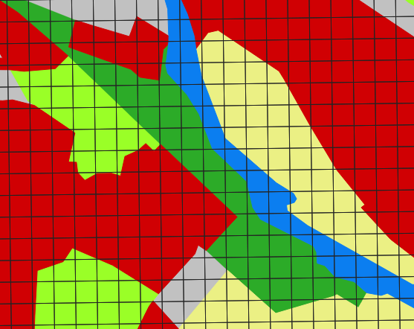
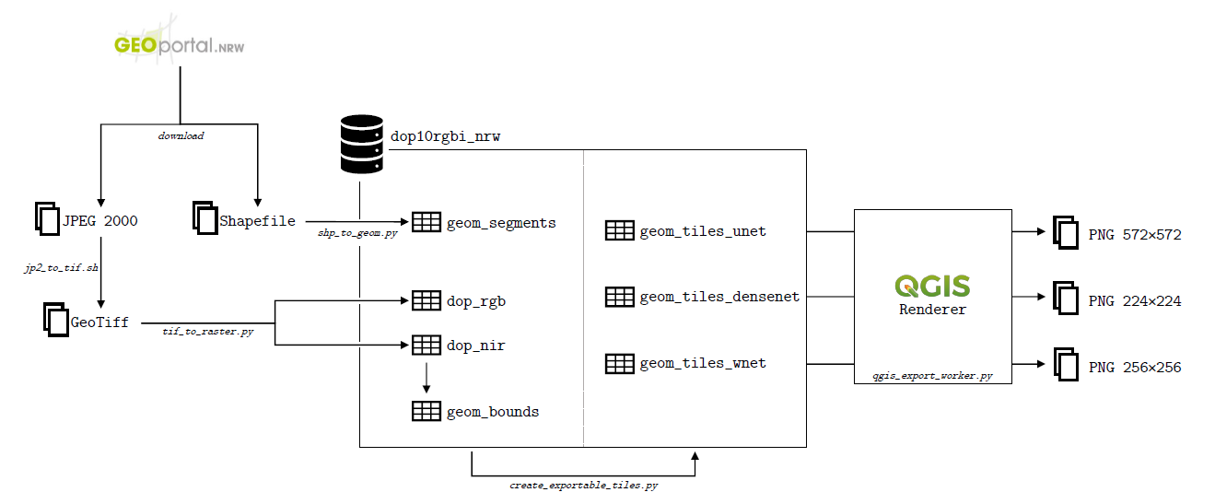
Preparations

Slide 20
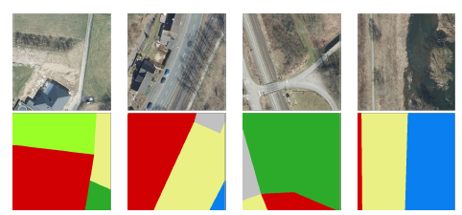
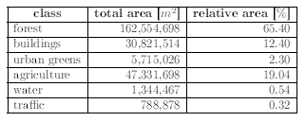
Considerations

Slide 21
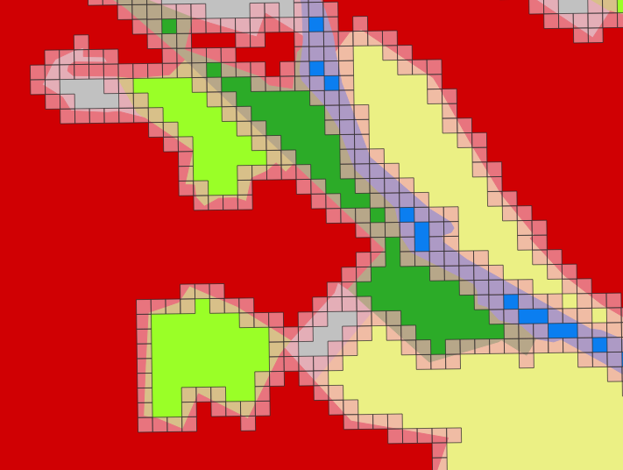
Class Imbalance
Many experiments with class weights -> no success

Slide 22
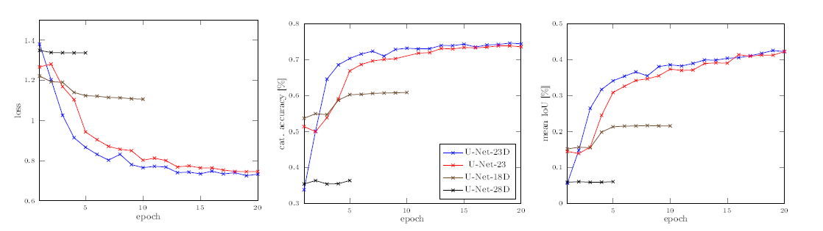
U-Net Experiments - Metrics
List configurations with variations and # of params

Slide 23
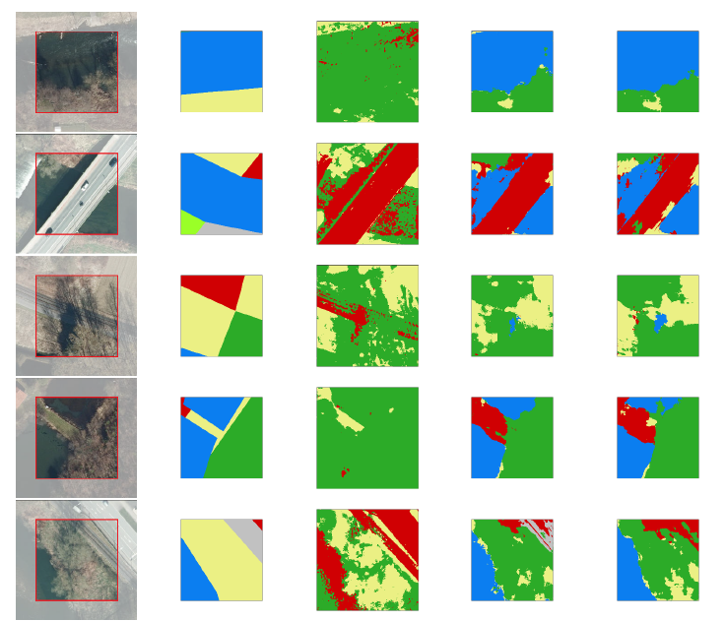
U-Net Experiments - Images

Slide 24
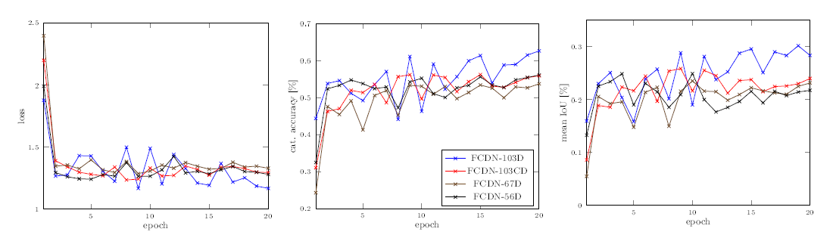
FC-DenseNet Experiments - Metrics
List configurations with variations and # of params

Slide 25
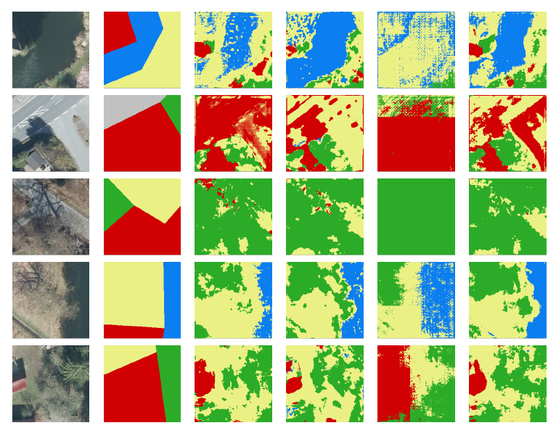
FC-DenseNet Experiments - Images

Slide 26
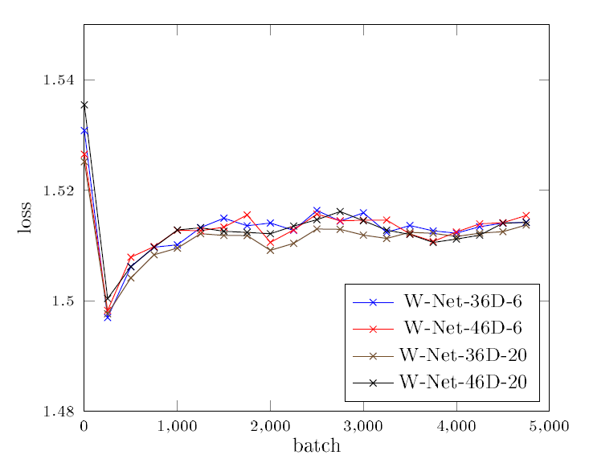
W-Net Experiments - Images
List configurations with variations and # of params

Slide 27
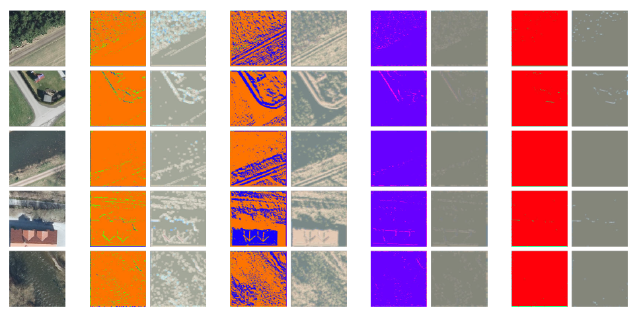
W-Net Experiments - Images

Slide 28
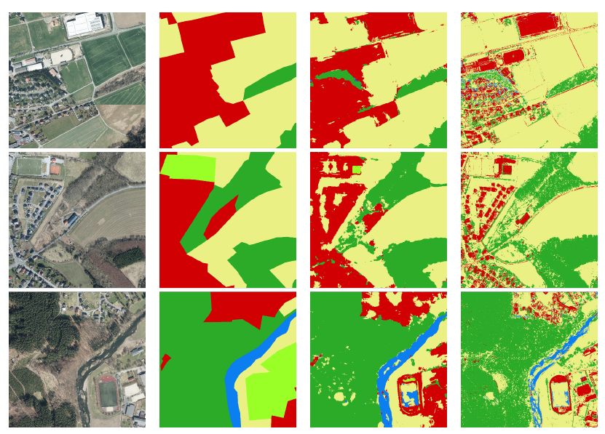
Larger Scale Images
Computation time?

Slide 29
Live Demo?
Show images, do live segmentation with U-Net and FC-DenseNet

Slide 30
Discussion

Slide 31
Vegetation Indices
Compares spectral bands of light

Slide 32
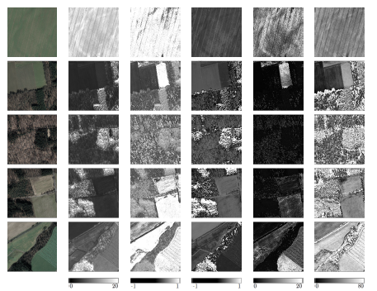
Ratio Vegetation Index

Slide 33
Normalized Difference Vegetation Index

Slide 34
Enhanced Vegetation Index

Slide 35
Soil-adjusted Vegetation Index

Slide 36
Modified soil-adjusted Vegetation Index?

Slide 37
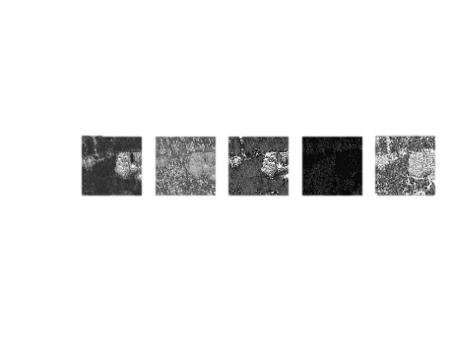
Discussion
Show different results, which one is correct?
Only green vegetation, no dead vegetation, no other obstacles
No information about height and robustness

Slide 38
Conclusion
Supervised learning was good, U-Net and FC-DenseNet can both be used, Further improvements possible
Desicion if rough or fine segmentations
Not more data, but more accurate labels, maybe other regions of world
Vegetation indices are OK, but not as standalone factor
No recommendation of which one to use, depending on sensor etc

